Slide 1
2.25.2021
Introduction to Xamarin.Forms
Kevin Ford
kevinf@magenic.com
617 359-5192

Slide 2
https://github.com/Magenic/IntroToXamarinForms

Slide 3
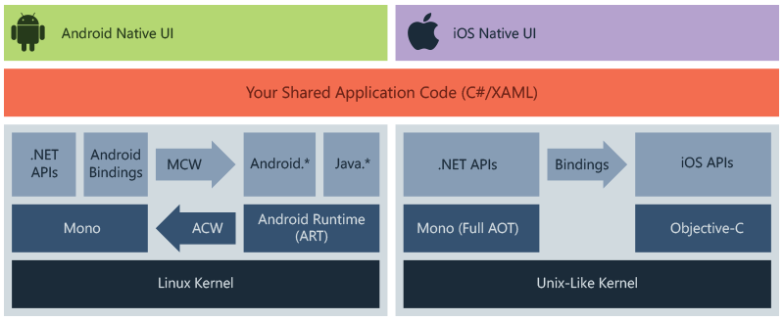
What is Xamarin?

Slide 4
What’s Xamarin Forms then?
Your Shared UI code
Xamarin Forms XAML Abstraction Layer
Components
Components

Slide 5
A Brief History of Xamarin
1999 – Ximian, Inc created to develop software for Linux and Unix
2000 - 2001 – Mono created as an attempt to port .Net to Linux as part of Ximian
2003– Novell purchases Ximian and Mono development continues
2007 – iOS and Android become ‘a thing’
2009 – MonoTouch released
2011 – Novell lays off Mono team, Xamarin formed as independent company by mono creators
2014 – Xamarin.Forms released
2016 – Microsoft purchases Xamarin
2021 –Xamarin retired, Xamarin and Xamarin.Forms becomes MAUI

Slide 6
I know C#, Is that enough?

Slide 7
Should I target Android, iOS or both?
https://gs.statcounter.com/android-version-market-share/mobile-tablet/worldwide
Who uses your app?
Can you control their devices?
Do you know the demographics?
What OS versions should you support (Fragmentation)
Fragmentation is now an iOS issue

Slide 8
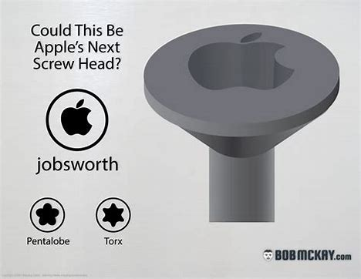
Why do all those mobile guys have Macs?
Dedicated mobile devs skew toward Macs
Many already have PCs
Windows and a Build server
Need fat pipe
iOS Simulator??????
Parallels needs horse-power

Slide 9
Speaking of Apple…
Apple Accounts
Enterprise vs. Store
Developer.apple.com
Needed for physical devices

Slide 10
How about Android
Self Signing
Not required for distribution
One time fee for store

Slide 11
If I make an app, how do I distribute it?
App Store
Side load? (Website, etc.)
Enterprise App Store
Testing Provider

Slide 12
How hard is it to get into the stores?

Slide 13
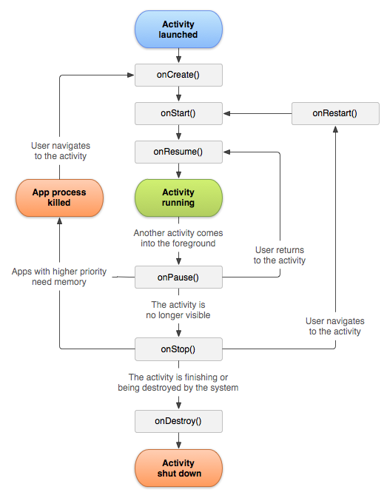
Android Lifecycle

Slide 14
iOS Lifecycle

Slide 15
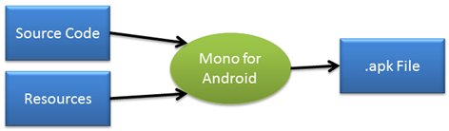
Android Resources
Contain Strings, Layouts, images, etc
Vary Based on Several Factors
Controlled by Directory Stricture
Language
Resolution
Orientation

Slide 16
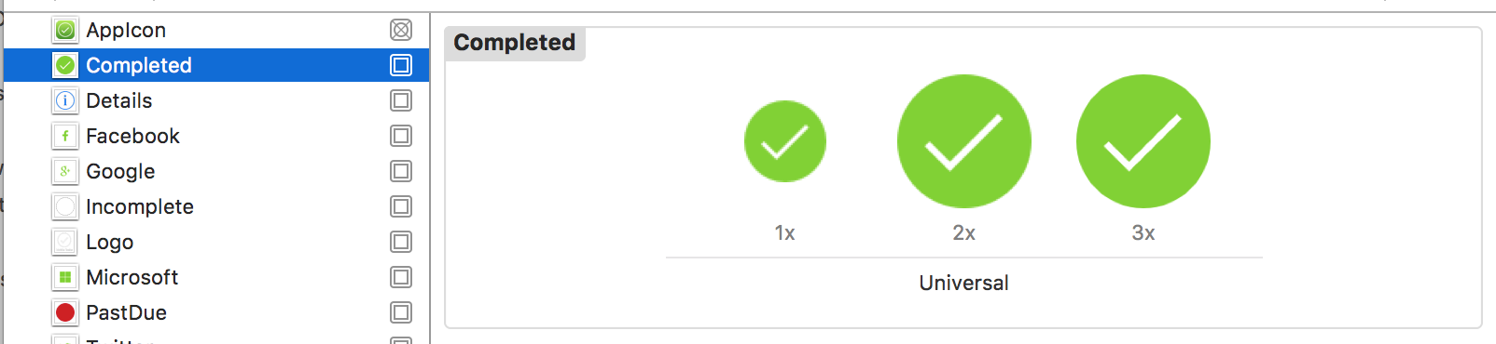
iOS Image Assets
XCAssets file
Some icons required – platform dependent
Image sizes based on file naming convention
Which icon used depends on device type

Slide 17
Demo: Creating a Xamarin Project

Slide 18
Homework
Setup Xamarin Android
Create new Forms App
Run on Android

Slide 19
Q & A
New week – Data binding

